Slide 1
14
Acquiring Information Systems and Applications

Slide 2
Planning for and Justifying IT Applications
Strategies for Acquiring IT Applications
The Traditional Systems Development Life Cycle
Alternative Methods and Tools for Systems Development
Vendor and Software Selection

Slide 3
Discuss the different cost–benefit analyses that companies must take into account when formulating an IT strategic plan.
Discuss the four business decisions that companies must make when they acquire new applications.

Slide 4
Enumerate the primary tasks and the importance of each of the six processes involved in the systems development life cycle.
Describe alternative development methods and the tools that augment development methods.
Analyze the process of vendor and soft ware selection.

Slide 5

LinkedIn’s Fast Development Process Helps Save the Company
Describe how freezing new feature development on its Web site “saved” LinkedIn.
Describe how rapid application development is enabling LinkedIn to add its next feature, mining users’ economic and job data.

Slide 6
14.1
Planning for and Justifying IT Applications
IT Planning
Evaluation and Justifying IT Investment: Benefits, Costs, and Issues

Slide 7
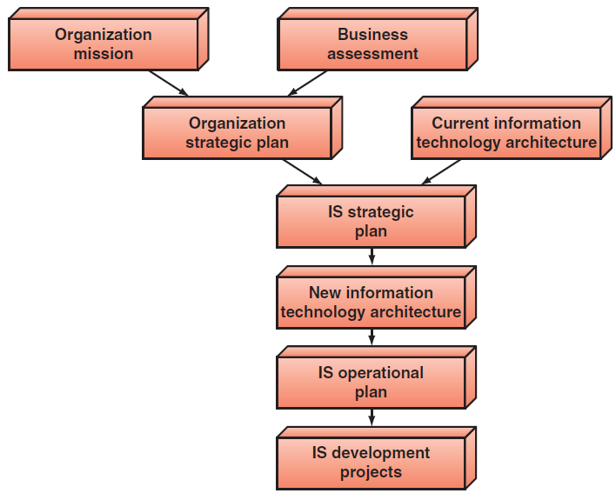
Figure 14.1: The IS Planning Process

Slide 8
IT Planning
Organizational Strategic Plan
IT Strategic Plan
IT Steering Committee
IS Operational Plan
Notes:
Organization Strategic Plan: identifies the firm’s overall mission, the goals that follow from that mission, and the broad steps required to reach these goals.
IT Strategic Plan: a set of long-range goals that describe the IT infrastructure and identify the major IT initiatives needed to achieve the organization’s goals.
IT Steering Committee: comprised of a group of managers and staff who represent the various organizational units, is created to establish IT priorities and to ensure that the MIS function is meeting the organization’s needs.
IS Operational Plan: consists of a clear set of projects that the IS department and the functional area managers will execute in support of the IT strategic plan.

Slide 9
IT Planning
Organization Strategic Plan: identifies the firm’s overall mission, the goals that follow from that mission, and the broad steps required to reach these goals.
IT Strategic Plan: a set of long-range goals that describe the IT infrastructure and identify the major IT initiatives needed to achieve the organization’s goals.
IT Steering Committee: comprised of a group of managers and staff who represent the various organizational units, is created to establish IT priorities and to ensure that the MIS function is meeting the organization’s needs.
IS Operational Plan: consists of a clear set of projects that the IS department and the functional area managers will execute in support of the IT strategic plan.
Notes:
Organization Strategic Plan: identifies the firm’s overall mission, the goals that follow from that mission, and the broad steps required to reach these goals.
IT Strategic Plan: a set of long-range goals that describe the IT infrastructure and identify the major IT initiatives needed to achieve the organization’s goals.
IT Steering Committee: comprised of a group of managers and staff who represent the various organizational units, is created to establish IT priorities and to ensure that the MIS function is meeting the organization’s needs.
IS Operational Plan: consists of a clear set of projects that the IS department and the functional area managers will execute in support of the IT strategic plan.

Slide 10
IT Strategic Plan
IT Strategic Plan: a set of long-range goals that describe the IT infrastructure and identify the major IT initiatives needed to achieve the organization’s goals.
Three Objectives of an IT Strategic Plan:
Must be aligned with the organization’s strategic plan. Alignment is critical because the organization’s information systems must support the organization’s strategies.
Provide for an IT architecture that seamlessly networks users, applications, and databases.
Efficiently allocate IS development resources among competing projects so that the projects can be completed on time and within budget and still have the required functionality.
Notes:
IT Strategic Plan: a set of long-range goals that describe the IT infrastructure and identify the major IT initiatives needed to achieve the organization’s goals.
Three Objectives of an IT Strategic Plan:
Must be aligned with the organization’s strategic plan. Alignment is critical because the organization’s information systems must support the organization’s strategies.
Provide for an IT architecture that seamlessly networks users, applications, and databases.
Efficiently allocate IS development resources among competing projects so that the projects can be completed on time and within budget and still have the required functionality.

Slide 11
IT Steering Committee
IT Steering Committee: comprised of a group of managers and staff who represent the various organizational units, is created to establish IT priorities and to ensure that the MIS function is meeting the organization’s needs.
Major Tasks of an IT Steering Committee:
Link corporate strategy with IT strategy
Approve the allocation of resources for the MIS function
Establish performance measures for the MIS function and ensure they are met
Notes:
IT Steering Committee: comprised of a group of managers and staff who represent the various organizational units, is created to establish IT priorities and to ensure that the MIS function is meeting the organization’s needs.
Major Tasks of an IT Steering Committee:
Link corporate strategy with IT strategy
Approve the allocation of resources for the MIS function
Establish performance measures for the MIS function and ensure they are met

Slide 12
IS Operational Plan
IS Operational Plan: consists of a clear set of projects that the IS department and the functional area managers will execute in support of the IT strategic plan.
Elements of an IS operational plan:
Mission: The mission of the IS function (derived from the IT strategy).
IS Environment: A summary of the information needs of the individual functional areas and of the organization as a whole.
Objectives of the IS Function: The best current estimate of the goals of the IS function.
Constraints on the IS function: Technological, financial, personnel, and other resource limitations on the IS function.
Application Portfolio: prioritized inventory of present applications and a detailed plan of projects to be developed or continued during the current year.
Resource Allocation and Project Management: A listing of who is going to do what, how, and when.
Notes:
IS Operational Plan: consists of a clear set of projects that the IS department and the functional area managers will execute in support of the IT strategic plan.
Elements of an IS operational plan:
Mission: The mission of the IS function (derived from the IT strategy).
IS Environment: A summary of the information needs of the individual functional areas and of the organization as a whole.
Objectives of the IS Function: The best current estimate of the goals of the IS function.
Constraints on the IS function: Technological, financial, personnel, and other resource limitations on the IS function.
Application Portfolio: prioritized inventory of present applications and a detailed plan of projects to be developed or continued during the current year.
Resource Allocation and Project Management: A listing of who is going to do what, how, and when.

Slide 13
Evaluation and Justifying IT Investment: Benefits, Costs, and Issues
Assessing the Costs
Assessing the Benefits
Conducting the Cost-Benefit Analysis
Notes:
Assessing the Costs: Calculating the dollar value of IT investments is not as simple as it may seem. One of the major challenges --> allocating fixed costs among different IT projects.
Fixed Costs: are those costs that remain the same regardless of any change in the company’s activity level (e.g., costs associated with infrastructure ,IT services, and IT management.
-----------------
Assessing the Benefits: benefits may be more difficult to quantify, especially because many of them are intangible.
-----------------

Slide 14
Evaluation and Justifying IT Investment: Benefits, Costs, and Issues
Assessing the Costs: Calculating the dollar value of IT investments is not as simple as it may seem. One of the major challenges --> allocating fixed costs among different IT projects.
Fixed Costs: are those costs that remain the same regardless of any change in the company’s activity level (e.g., costs associated with infrastructure ,IT services, and IT management.
-----------------
Assessing the Benefits: benefits may be more difficult to quantify, especially because many of them are intangible.
-----------------
Notes:
Assessing the Costs: Calculating the dollar value of IT investments is not as simple as it may seem. One of the major challenges --> allocating fixed costs among different IT projects.
Fixed Costs: are those costs that remain the same regardless of any change in the company’s activity level (e.g., costs associated with infrastructure ,IT services, and IT management.
-----------------
Assessing the Benefits: benefits may be more difficult to quantify, especially because many of them are intangible.
-----------------

Slide 15
Conducting the Cost-Benefit Analysis
Four Common Approaches for Cost-Benefit Analysis:
Net Present Value
Return on Investment (ROI)
Breakeven Analysis
Business Case Approach
Notes:
Four Common Approaches for Cost-Benefit Analysis:
Net Present Value: Analysts use the net present value (NPV) method to convert future values of benefits to their present-value equivalent by “discounting” them at the organization’s cost of funds. Th ey can then compare the present value of the future benefi ts with the cost required to achieve those benefits to determine whether the benefits exceed the costs.
Return on Investment (ROI): measures management’s effectiveness in generating profits with its available assets. ROI is calculated by dividing the net income generated by a project by the average assets invested in the project. ROI is a percentage, and the higher the percentage return, the better.
Breakeven Analysis: determines the point at which the cumulative dollar value of the benefits from a project equals the investment made in the project.
Business Case Approach: system developers write a business case to justify funding one or more specific applications or projects. IS professionals will be a major source of input when business cases are developed because these cases describe what you do, how you do it, and how a new system could better support you.

Slide 16
Conducting the Cost-Benefit Analysis
Four Common Approaches for Cost-Benefit Analysis:
Net Present Value: Analysts use the net present value (NPV) method to convert future values of benefits to their present-value equivalent by “discounting” them at the organization’s cost of funds. Th ey can then compare the present value of the future benefi ts with the cost required to achieve those benefits to determine whether the benefits exceed the costs.
Return on Investment (ROI): measures management’s effectiveness in generating profits with its available assets. ROI is calculated by dividing the net income generated by a project by the average assets invested in the project. ROI is a percentage, and the higher the percentage return, the better.
Breakeven Analysis: determines the point at which the cumulative dollar value of the benefits from a project equals the investment made in the project.
Business Case Approach: system developers write a business case to justify funding one or more specific applications or projects. IS professionals will be a major source of input when business cases are developed because these cases describe what you do, how you do it, and how a new system could better support you.
Notes:
Four Common Approaches for Cost-Benefit Analysis:
Net Present Value: Analysts use the net present value (NPV) method to convert future values of benefits to their present-value equivalent by “discounting” them at the organization’s cost of funds. Th ey can then compare the present value of the future benefi ts with the cost required to achieve those benefits to determine whether the benefits exceed the costs.
Return on Investment (ROI): measures management’s effectiveness in generating profits with its available assets. ROI is calculated by dividing the net income generated by a project by the average assets invested in the project. ROI is a percentage, and the higher the percentage return, the better.
Breakeven Analysis: determines the point at which the cumulative dollar value of the benefits from a project equals the investment made in the project.
Business Case Approach: system developers write a business case to justify funding one or more specific applications or projects. IS professionals will be a major source of input when business cases are developed because these cases describe what you do, how you do it, and how a new system could better support you.

Slide 17
14.2
Strategies for Acquiring IT Applications
Fundamental Decisions
Acquisition Methods

Slide 18
Fundamental Decisions
Fundamental Decisions in IT Application Acquistion:
How much computer code does the company want to write? A company can choose to use a totally prewritten application (write no computer code), to customize a prewritten application (write some computer code), or to custom-write an entire application (write all new computer code).
How will the company pay for the application? Once the company has decided how much computer code to write, it must decide how to pay for it. With prewritten applications or customized prewritten applications, companies can buy them or lease them. With totally custom applications, companies use internal funding.
Where will the application run? The next decision is whether to run the application on the company’s platform or on someone else’s platform. In other words, the company can employ either a soft ware-as-a-service vendor or an application service provider.
Where will the application originate? Prewritten applications can be open-source software or they can come from a vendor. Th e company may choose to customize prewritten open-source applications or prewritten proprietary applications from vendors.
Notes:
Fundamental Decisions in IT Application Acquistion:
How much computer code does the company want to write? A company can choose to use a totally prewritten application (write no computer code), to customize a prewritten application (write some computer code), or to custom-write an entire application (write all new computer code).
How will the company pay for the application? Once the company has decided how much computer code to write, it must decide how to pay for it. With prewritten applications or customized prewritten applications, companies can buy them or lease them. With totally custom applications, companies use internal funding.
Where will the application run? The next decision is whether to run the application on the company’s platform or on someone else’s platform. In other words, the company can employ either a soft ware-as-a-service vendor or an application service provider.
Where will the application originate? Prewritten applications can be open-source software or they can come from a vendor. Th e company may choose to customize prewritten open-source applications or prewritten proprietary applications from vendors.

Slide 19
Acquisition Methods
Purchase a Prewritten Application
Customize a Prewritten Application
Lease the Application
Application Service Provider (ASP)
Software-as-a-Service (SaaS)
Use Open-Source Software
Outsourcing
Employ Custom Development
Notes:
Purchase a Prewritten Application: Many commercial soft ware packages contain the standard features required by IT applications. Therefore, purchasing an existing package can be a cost-effective and time-saving strategy compared with custom-developing the application in-house.
Customize a Prewritten Application: Customizing existing software is an especially attractive option if the software vendor allows the company to modify the application to meet its needs. However, this option may not be attractive in cases where customization is the only method of providing the necessary flexibility to address the company’s needs. It also is not the best strategy when the software is either very expensive or likely to become obsolete in a short time.
Lease the Application: Compared with the buy option and the option to develop applications in-house, the lease option can save a company both time and money. Leased packages (like purchased packages) may not exactly fit the company’s application requirements. Leasing can be especially attractive to small and medium-sized enterprises (SMEs) that cannot aff ord major investments in IT software.
Application Service Provider (ASP): an agent or a vendor who assembles the software needed by enterprises and then packages it with services such as development, operations, and maintenance. The customer then accesses these applications via the Internet.
Software-as-a-Service (SaaS): a method of delivering software in which a vendor hosts the applications and provides them as a service to customers over a network, typically the Internet. Customers do not own the software; rather, they pay for using it. SaaS eliminates the need for customers to install and run the application on their own computers. Therefore, SaaS customers save the expense (money, time, IT staff) of buying, operating, and maintaining the software.
Use Open-Source Software: Organizations obtain a license to implement an open-source soft ware product and either use it as is, customize it, or develop applications with it.
Outsourcing: Acquiring IT applications from outside contractors or external organizations is called outsourcing.
Employ Custom Development: Another option is to custom-build an application. Companies can either perform this operation in-house or outsource the process.

Slide 20
Acquisition Methods
Purchase a Prewritten Application: Many commercial soft ware packages contain the standard features required by IT applications. Therefore, purchasing an existing package can be a cost-effective and time-saving strategy compared with custom-developing the application in-house.
Customize a Prewritten Application: Customizing existing software is an especially attractive option if the software vendor allows the company to modify the application to meet its needs. However, this option may not be attractive in cases where customization is the only method of providing the necessary flexibility to address the company’s needs. It also is not the best strategy when the software is either very expensive or likely to become obsolete in a short time.
Lease the Application: Compared with the buy option and the option to develop applications in-house, the lease option can save a company both time and money. Leased packages (like purchased packages) may not exactly fit the company’s application requirements. Leasing can be especially attractive to small and medium-sized enterprises (SMEs) that cannot aff ord major investments in IT software.
Notes:
Purchase a Prewritten Application: Many commercial soft ware packages contain the standard features required by IT applications. Therefore, purchasing an existing package can be a cost-effective and time-saving strategy compared with custom-developing the application in-house.
Customize a Prewritten Application: Customizing existing software is an especially attractive option if the software vendor allows the company to modify the application to meet its needs. However, this option may not be attractive in cases where customization is the only method of providing the necessary flexibility to address the company’s needs. It also is not the best strategy when the software is either very expensive or likely to become obsolete in a short time.
Lease the Application: Compared with the buy option and the option to develop applications in-house, the lease option can save a company both time and money. Leased packages (like purchased packages) may not exactly fit the company’s application requirements. Leasing can be especially attractive to small and medium-sized enterprises (SMEs) that cannot aff ord major investments in IT software.
Application Service Provider (ASP): an agent or a vendor who assembles the software needed by enterprises and then packages it with services such as development, operations, and maintenance. The customer then accesses these applications via the Internet.
Software-as-a-Service (SaaS): a method of delivering software in which a vendor hosts the applications and provides them as a service to customers over a network, typically the Internet. Customers do not own the software; rather, they pay for using it. SaaS eliminates the need for customers to install and run the application on their own computers. Therefore, SaaS customers save the expense (money, time, IT staff) of buying, operating, and maintaining the software.
Use Open-Source Software: Organizations obtain a license to implement an open-source soft ware product and either use it as is, customize it, or develop applications with it.
Outsourcing: Acquiring IT applications from outside contractors or external organizations is called outsourcing.
Employ Custom Development: Another option is to custom-build an application. Companies can either perform this operation in-house or outsource the process.

Slide 21
Acquisition Methods
Application Service Provider (ASP): an agent or a vendor who assembles the software needed by enterprises and then packages it with services such as development, operations, and maintenance. The customer then accesses these applications via the Internet.
Software-as-a-Service (SaaS): a method of delivering software in which a vendor hosts the applications and provides them as a service to customers over a network, typically the Internet. Customers do not own the software; rather, they pay for using it. SaaS eliminates the need for customers to install and run the application on their own computers. Therefore, SaaS customers save the expense (money, time, IT staff) of buying, operating, and maintaining the software.
Use Open-Source Software: Organizations obtain a license to implement an open-source soft ware product and either use it as is, customize it, or develop applications with it.
Outsourcing: Acquiring IT applications from outside contractors or external organizations is called outsourcing.
Employ Custom Development: Another option is to custom-build an application. Companies can either perform this operation in-house or outsource the process.
Notes:
Purchase a Prewritten Application: Many commercial soft ware packages contain the standard features required by IT applications. Therefore, purchasing an existing package can be a cost-effective and time-saving strategy compared with custom-developing the application in-house.
Customize a Prewritten Application: Customizing existing software is an especially attractive option if the software vendor allows the company to modify the application to meet its needs. However, this option may not be attractive in cases where customization is the only method of providing the necessary flexibility to address the company’s needs. It also is not the best strategy when the software is either very expensive or likely to become obsolete in a short time.
Lease the Application: Compared with the buy option and the option to develop applications in-house, the lease option can save a company both time and money. Leased packages (like purchased packages) may not exactly fit the company’s application requirements. Leasing can be especially attractive to small and medium-sized enterprises (SMEs) that cannot aff ord major investments in IT software.
Application Service Provider (ASP): an agent or a vendor who assembles the software needed by enterprises and then packages it with services such as development, operations, and maintenance. The customer then accesses these applications via the Internet.
Software-as-a-Service (SaaS): a method of delivering software in which a vendor hosts the applications and provides them as a service to customers over a network, typically the Internet. Customers do not own the software; rather, they pay for using it. SaaS eliminates the need for customers to install and run the application on their own computers. Therefore, SaaS customers save the expense (money, time, IT staff) of buying, operating, and maintaining the software.
Use Open-Source Software: Organizations obtain a license to implement an open-source soft ware product and either use it as is, customize it, or develop applications with it.
Outsourcing: Acquiring IT applications from outside contractors or external organizations is called outsourcing.
Employ Custom Development: Another option is to custom-build an application. Companies can either perform this operation in-house or outsource the process.

Slide 22
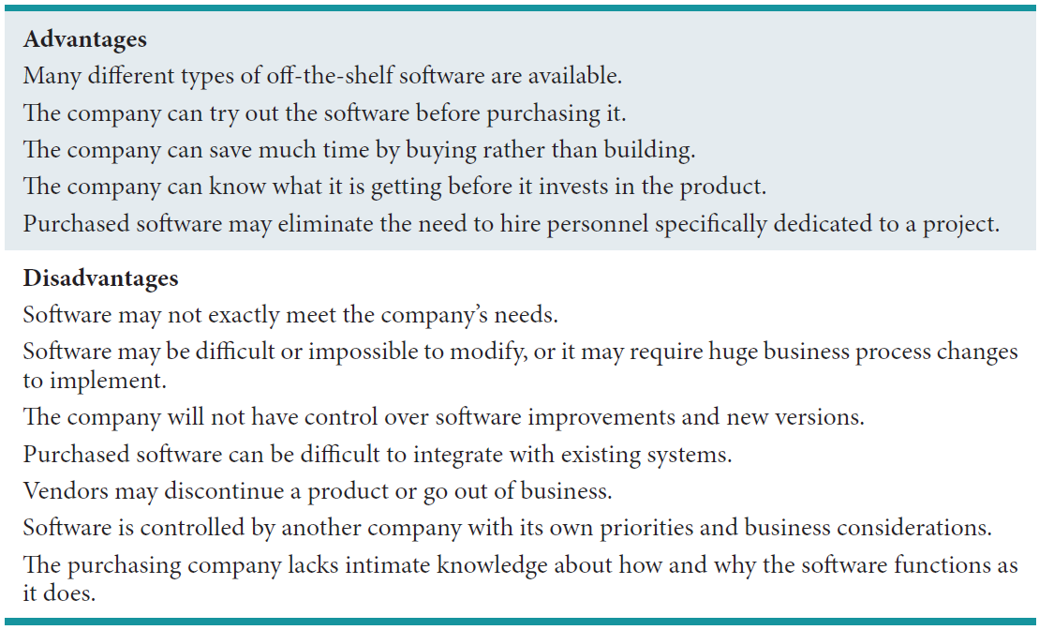
Table 14.1: Advantages & Disadvantages of Buy Option

Slide 23
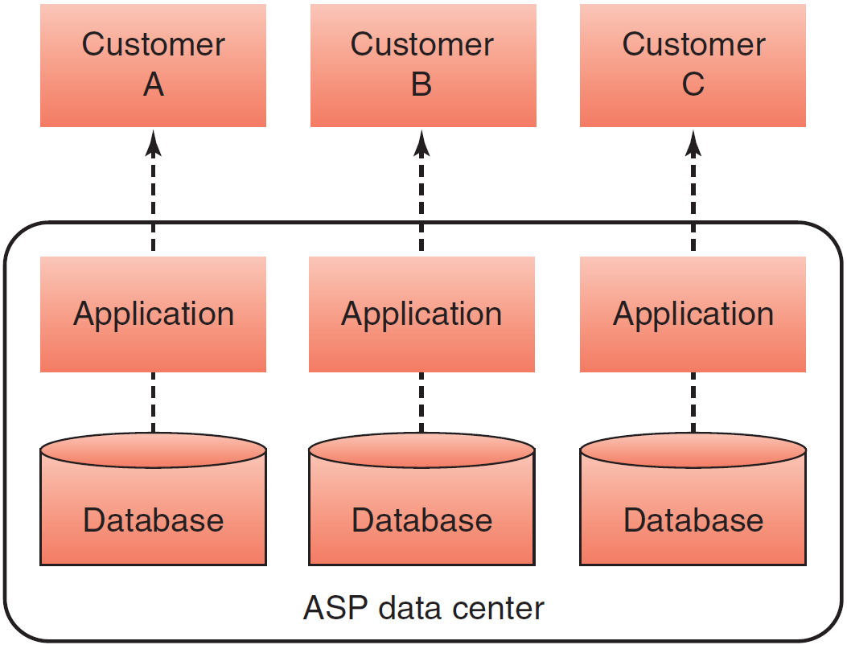
Figure 14.2: Operation of an ASP

Slide 24
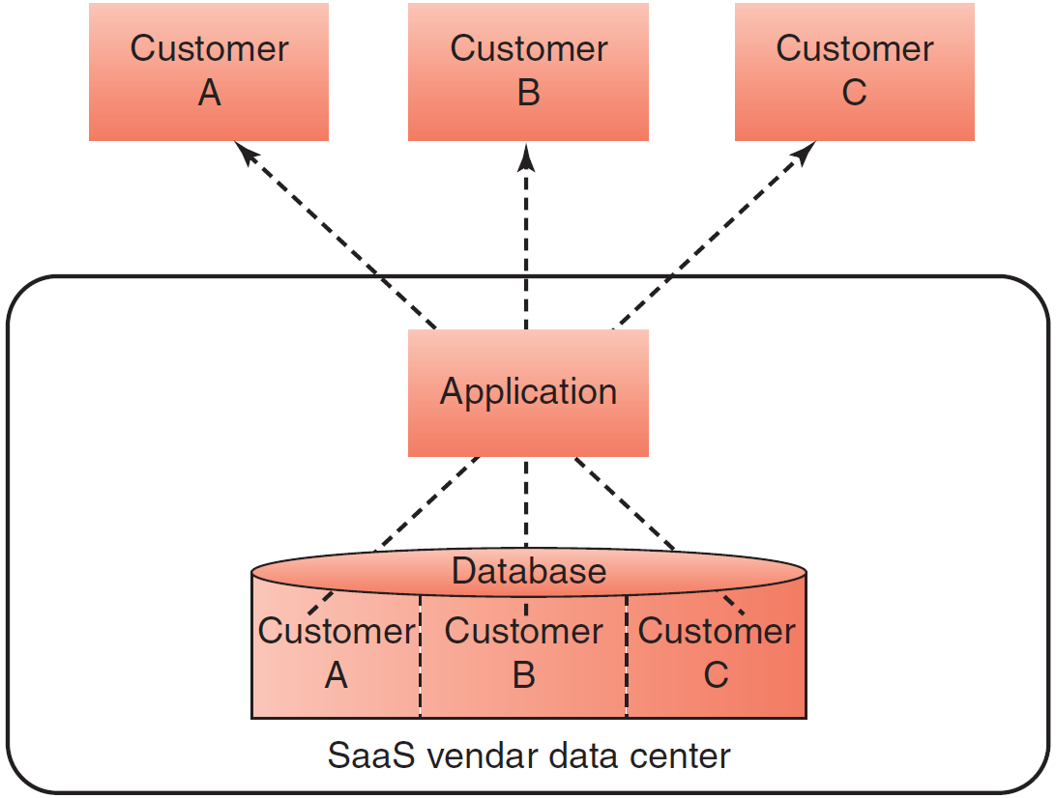
Figure 14.3: Operation of a SaaS Vendor

Slide 25
’S ABOUT BUSINESS 14.1
A Disastrous Development Project
Debate the lawsuit from the point of view of Deloitte and SAP.
Debate the lawsuit from the point of view of Marin County.
Is it a good idea for Marin County to attempt another ERP implementation? Why or why not? Support your answer.
Are there other types of software that Marin County might use? (Hint: Consider cloud computing (see Plug IT In 4).)
Is it a good idea for Marin County to use software products from different vendors? Why or why not? Support your answer.

Slide 26
’S ABOUT BUSINESS 14.2
General Motors Insources Its Information Technology Function
What are potential disadvantages of Mott’s insourcing strategy?
Why did GM’s outsourcing strategy result in the company’s using 4,000 software applications? In your opinion, will Mott’s insourcing strategy resolve this problem? Why or why not?

Slide 27
’S ABOUT BUSINESS 14.3
Build Your Apps Yourself
What are the advantages of learning to code so that you can build your own mobile apps? Provide specific examples to support your answer.
What are the disadvantages of learning to code so that you can build your own mobile apps? Provide specific examples to support your answer.

Slide 28
14.3
The Traditional Systems Development Life Cycle
Systems Development Life Cycle (SDLC)
Systems Investigation
Systems Analysis
Systems Design
Programming and Testing
Implementation
Operations and Maintenance
Notes:
Systems Development Life Cycle (SDLC): the traditional systems development method that organizations use for large-scale IT projects. The SDLC is a structured framework that consists of sequential processes by which information systems are developed.
Systems Analysts: IS professionals who specialize in analyzing and designing information systems.
Programmers: IS professionals who either modify existing computer programs or write new programs to satisfy user requirements.
Technical Specialists: experts on a certain type of technology, such as databases or telecommunications.
Systems Stakeholders: include everyone who is affected by changes in a company’s information systems—for example, users and managers. All stakeholders are typically involved in systems development at various times and in varying degrees.

Slide 29
14.3
The Traditional Systems Development Life Cycle
Systems Development Life Cycle (SDLC): the traditional systems development method that organizations use for large-scale IT projects. The SDLC is a structured framework that consists of sequential processes by which information systems are developed.
Systems Analysts: IS professionals who specialize in analyzing and designing information systems.
Programmers: IS professionals who either modify existing computer programs or write new programs to satisfy user requirements.
Technical Specialists: experts on a certain type of technology, such as databases or telecommunications.
Systems Stakeholders: include everyone who is affected by changes in a company’s information systems—for example, users and managers. All stakeholders are typically involved in systems development at various times and in varying degrees.
Notes:
Systems Development Life Cycle (SDLC): the traditional systems development method that organizations use for large-scale IT projects. The SDLC is a structured framework that consists of sequential processes by which information systems are developed.
Systems Analysts: IS professionals who specialize in analyzing and designing information systems.
Programmers: IS professionals who either modify existing computer programs or write new programs to satisfy user requirements.
Technical Specialists: experts on a certain type of technology, such as databases or telecommunications.
Systems Stakeholders: include everyone who is affected by changes in a company’s information systems—for example, users and managers. All stakeholders are typically involved in systems development at various times and in varying degrees.

Slide 30
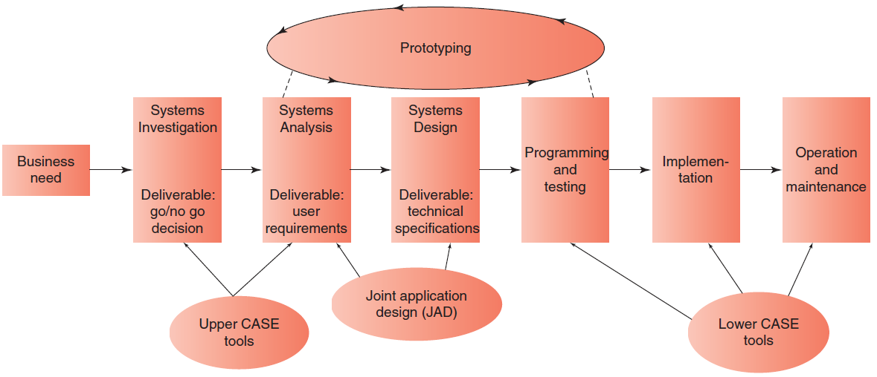
Figure 14.4: A six-stage SDLC with Supporting Tools

Slide 31
SDLC: Systems Investigation
Systems Investigation: The initial stage in a traditional SDLC is systems investigation, and the primary task in the systems investigation stage is the feasibility study.
Organizations have three basic solutions to any business problem relating to an information system:
(1) do nothing and continue to use the existing system unchanged
(2) modify or enhance the existing system
(3) develop a new system.
Feasibility Study: analyzes which of three basic solutions best fits the particular business problem. It also provides a rough assessment of the project’s technical, economic, and behavioral feasibility, as explained below.
Technical Feasibility: determines whether the company can develop and/or acquire the hardware, soft ware, and communications components needed to solve the business problem. Technical feasibility also determines whether the organization can use its existing technology to achieve the project’s performance objectives.
Economic Feasibility: determines whether the project is an acceptable financial risk and, if so, whether the organization has the necessary time and money to successfully complete the project.
Behavioral Feasibility: addresses the human issues of the systems development project.
Outcome of the Feasibility Study is a “go/no-go” decision
Notes:
Systems Investigation: The initial stage in a traditional SDLC is systems investigation, and the primary task in the systems investigation stage is the feasibility study.
Organizations have three basic solutions to any business problem relating to an information system:
(1) do nothing and continue to use the existing system unchanged
(2) modify or enhance the existing system
(3) develop a new system.
Feasibility Study: analyzes which of three basic solutions best fits the particular business problem. It also provides a rough assessment of the project’s technical, economic, and behavioral feasibility, as explained below.
Technical Feasibility: determines whether the company can develop and/or acquire the hardware, soft ware, and communications components needed to solve the business problem. Technical feasibility also determines whether the organization can use its existing technology to achieve the project’s performance objectives.
Economic Feasibility: determines whether the project is an acceptable financial risk and, if so, whether the organization has the necessary time and money to successfully complete the project.
Behavioral Feasibility: addresses the human issues of the systems development project.
Outcome of the Feasibility Study is a “go/no-go” decision

Slide 32
Systems Investigation: Three Basic Solutions
Do nothing and continue to use the existing system unchanged
Modify or enhance the existing system
Develop a new system.

Slide 33
Systems Investigation: Feasibility Study
Feasibility Study: analyzes which of three basic solutions best fits the particular business problem. It also provides a rough assessment of the project’s technical, economic, and behavioral feasibility, as explained below.
Technical Feasibility: determines whether the company can develop and/or acquire the hardware, soft ware, and communications components needed to solve the business problem. Technical feasibility also determines whether the organization can use its existing technology to achieve the project’s performance objectives.
Economic Feasibility: determines whether the project is an acceptable financial risk and, if so, whether the organization has the necessary time and money to successfully complete the project.
Behavioral Feasibility: addresses the human issues of the systems development project.
Outcome of the Feasibility Study is a “go/no-go” decision
Notes:
Feasibility Study: analyzes which of three basic solutions best fits the particular business problem. It also provides a rough assessment of the project’s technical, economic, and behavioral feasibility, as explained below.
Technical Feasibility: determines whether the company can develop and/or acquire the hardware, soft ware, and communications components needed to solve the business problem. Technical feasibility also determines whether the organization can use its existing technology to achieve the project’s performance objectives.
Economic Feasibility: determines whether the project is an acceptable financial risk and, if so, whether the organization has the necessary time and money to successfully complete the project.
Behavioral Feasibility: addresses the human issues of the systems development project.
Outcome of the Feasibility Study is a “go/no-go” decision

Slide 34
SDLC:
Systems Analysis
Systems analysis: the process whereby systems analysts examine the business problem that the organization plans to solve with an information system. Systems analysis deliverable is a set of system requirements.
User Requirements: identifying business requirements the system must satisfy which is provided by users. This is often the most difficult task in systems analysis.
Deliverable:
A set of system requirements (or User Requirements)
Notes:
Systems analysis: the process whereby systems analysts examine the business problem that the organization plans to solve with an information system. Systems analysis deliverable is a set of system requirements.
User Requirements: identifying business requirements the system must satisfy which is provided by users. This is often the most difficult task in systems analysis.

Slide 35
SLDC:
Systems Design
Systems Design: describes how the system will resolve the business problem.
Deliverable: a set of technical system specifications.
Technical Specifications include following:
• System outputs, inputs, and user interfaces
• Hardware, soft ware, databases, telecommunications, personnel, and procedures
• A blueprint of how these components are integrated
Scope Creep: Adding functions after the project has been initiated causes the time frame and expenses associated with the project expand beyond the agreed-upon limits.
Notes:
Systems Design: describes how the system will resolve the business problem.
Deliverable: a set of technical system specifications.
Technical Specifications include following:
• System outputs, inputs, and user interfaces
• Hardware, soft ware, databases, telecommunications, personnel, and procedures
• A blueprint of how these components are integrated
Scope Creep: Adding functions after the project has been initiated causes the time frame and expenses associated with the project expand beyond the agreed-upon limits.

Slide 36
Systems Design:
Technical Specifications
Technical Specifications include following:
System outputs, inputs, and user interfaces
Hardware, software, databases, telecommunications, personnel, and procedures
A blueprint of how these components are integrated

Slide 37
SDLC:
Programming and Testing
Programming: involves translating the design specifications into computer code.
Testing: the process that assesses whether the computer code will produce the expected and desired results.
Notes:
Programming: involves translating the design specifications into computer code.
Testing: the process that assesses whether the computer code will produce the expected and desired results.

Slide 38
SDLC:
Implementation
Implementation (or deployment): the process of converting from an old computer system to a new one.
Three Major Conversion Strategies:
Direct Conversion: the old system is cut off , and the new system is turned on at a certain point in time. This type of conversion is the least expensive and the most risky.
Pilot Conversion: introduces the new system in one part of the organization, such as in one plant or one functional area. The new system runs for a period of time and is then assessed. If the assessment confirms that the system is working properly, then the system is implemented in other parts of the organization.
Phased Conversion: introduces components of the new system, such as individual modules, in stages. Each module is assessed. If it works properly, then other modules are introduced, until the entire new system is operational.
---------------------
Parallel Conversion: old and new systems operate simultaneously for a time, but this strategy is seldom used today.
Notes:
Implementation (or deployment): the process of converting from an old computer system to a new one.
Three Major Conversion Strategies:
Direct Conversion: the old system is cut off , and the new system is turned on at a certain point in time. This type of conversion is the least expensive and the most risky.
Pilot Conversion: introduces the new system in one part of the organization, such as in one plant or one functional area. The new system runs for a period of time and is then assessed. If the assessment confirms that the system is working properly, then the system is implemented in other parts of the organization.
Phased Conversion: introduces components of the new system, such as individual modules, in stages. Each module is assessed. If it works properly, then other modules are introduced, until the entire new system is operational.
---------------------
Parallel Conversion: old and new systems operate simultaneously for a time, but this strategy is seldom used today.

Slide 39

’S ABOUT BUSINESS 14.4
Avon Writes Off $125 Million on Failed Software Implementation
Is the Avon failure the fault of Avon? SAP? IBM? All three? Explain your answer.
Recall the discussion of strategic information systems in Chapter 2. Is Avon’s new system a strategic information system? Why or why not? Explain your answer.

Slide 40
SDLC: Operations & Maintenance
Operation and Maintenance: once a new system’s operations are stabilized, the company performs audits to assess the system’s capabilities and to determine if it is being utilized correctly.
Systems Require Several Types of Maintenance:
Debugging: (the system) a process that continues throughout the life of the system.
Updating: (the system) to accommodate changes in business conditions (e.g., adjusting to new governmental regulations).
Adding: new functions added to the existing system without disturbing its operation
Notes:
Operation and Maintenance: once a new system’s operations are stabilized, the company performs audits to assess the system’s capabilities and to determine if it is being utilized correctly.
Systems Require Several Types of Maintenance:
Debugging: (the system) a process that continues throughout the life of the system.
Updating: (the system) to accommodate changes in business conditions (e.g., adjusting to new governmental regulations).
Adding: new functions added to the existing system without disturbing its operation

Slide 41
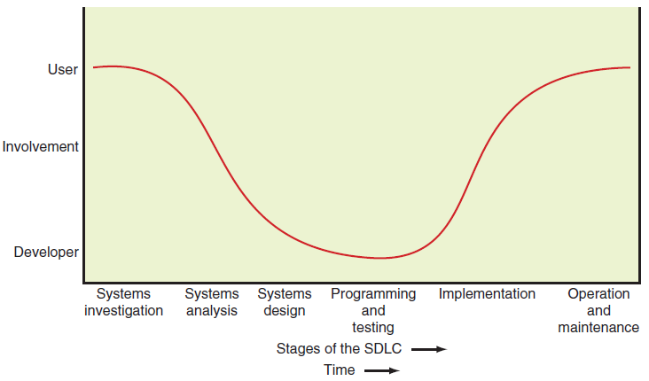
Figure 14.5: Comparison of user & Developer Involvement Over the SDLC

Slide 42
14.4
Alternative Methods and Tools for Systems Development
Joint Application Development
Rapid Application Development
Agile Development
End-User Development
Tools for Systems Development
Notes:
Joint Application Design (JAD): a group-based tool for collecting user requirements and creating system designs. It is most often used within the systems analysis and systems design stages of the SDLC. JAD involves a group meeting attended by the analysts and all of the users that can be conducted either in person or via the computer. During this meeting, all users jointly define and agree on the systems requirements.
Rapid Application Development (RAD): a systems development method that can combine JAD, prototyping, and integrated computer-assisted software engineering (ICASE) tools to rapidly produce a high-quality system. In the first RAD stage, developers use JAD sessions to collect system requirements. This strategy ensures that users are intensively involved early on. The development process in RAD is iterative.
Agile Development: a software development methodology that delivers functionality in rapid iterations, which are usually measured in weeks. To be successful, this methodology requires frequent communication, development, testing, and delivery.
End-User Development: an approach in which the organization’s end users develop their own applications with little or no formal assistance from the IT department.
Tools for Systems Development:
prototyping
integrated computer-assisted software engineering
component-based development,
object-oriented development.
Prototyping: a development approach that defines an initial list of user requirements, builds a model of the system, and then refines the system in several iterations based on users’ feedback. Developers quickly develop a smaller version of the system.
Integrated Computer-Assisted Software Engineering Tools (CASE): a group of tools that automate many of the tasks in the SDLC.
Upper Case Tools: used to automate the early stages of the SDLC (systems investigation, analysis, and design).
Lower Case Tools: used to automate later stages in the SDLC (programming, testing, operation, and maintenance).
Integrated CASE (ICASE) Tools: provide links between upper CASE and lower CASE tools.
Component-Based Development: uses standard components to build applications. Components are reusable applications that generally have one specific function, such as a shopping cart, user authentication, or a catalog.
Object-Oriented Development: based on a different view of computer systems than the perception that characterizes traditional development approaches. An object-oriented (OO) system begins not with the task to be performed, but with the aspects of the real world that must be modeled to perform that task.

Slide 43
14.4
Alternative Methods and Tools for Systems Development
Joint Application Design (JAD): a group-based tool for collecting user requirements and creating system designs. It is most often used within the systems analysis and systems design stages of the SDLC. JAD involves a group meeting attended by the analysts and all of the users that can be conducted either in person or via the computer. During this meeting, all users jointly define and agree on the systems requirements.
Rapid Application Development (RAD): a systems development method that can combine JAD, prototyping, and integrated computer-assisted software engineering (ICASE) tools to rapidly produce a high-quality system. In the first RAD stage, developers use JAD sessions to collect system requirements. This strategy ensures that users are intensively involved early on. The development process in RAD is iterative.
Agile Development: a software development methodology that delivers functionality in rapid iterations, which are usually measured in weeks. To be successful, this methodology requires frequent communication, development, testing, and delivery.
End-User Development: an approach in which the organization’s end users develop their own applications with little or no formal assistance from the IT department.
Tools for Systems Development:
prototyping
integrated computer-assisted software engineering
component-based development,
object-oriented development.
Prototyping: a development approach that defines an initial list of user requirements, builds a model of the system, and then refines the system in several iterations based on users’ feedback. Developers quickly develop a smaller version of the system.
Integrated Computer-Assisted Software Engineering Tools (CASE): a group of tools that automate many of the tasks in the SDLC.
Upper Case Tools: used to automate the early stages of the SDLC (systems investigation, analysis, and design).
Lower Case Tools: used to automate later stages in the SDLC (programming, testing, operation, and maintenance).
Integrated CASE (ICASE) Tools: provide links between upper CASE and lower CASE tools.
Component-Based Development: uses standard components to build applications. Components are reusable applications that generally have one specific function, such as a shopping cart, user authentication, or a catalog.
Object-Oriented Development: based on a different view of computer systems than the perception that characterizes traditional development approaches. An object-oriented (OO) system begins not with the task to be performed, but with the aspects of the real world that must be modeled to perform that task.
Notes:
Joint Application Design (JAD): a group-based tool for collecting user requirements and creating system designs. It is most often used within the systems analysis and systems design stages of the SDLC. JAD involves a group meeting attended by the analysts and all of the users that can be conducted either in person or via the computer. During this meeting, all users jointly define and agree on the systems requirements.
Rapid Application Development (RAD): a systems development method that can combine JAD, prototyping, and integrated computer-assisted software engineering (ICASE) tools to rapidly produce a high-quality system. In the first RAD stage, developers use JAD sessions to collect system requirements. This strategy ensures that users are intensively involved early on. The development process in RAD is iterative.
Agile Development: a software development methodology that delivers functionality in rapid iterations, which are usually measured in weeks. To be successful, this methodology requires frequent communication, development, testing, and delivery.
End-User Development: an approach in which the organization’s end users develop their own applications with little or no formal assistance from the IT department.
Tools for Systems Development:
prototyping
integrated computer-assisted software engineering
component-based development,
object-oriented development.
Prototyping: a development approach that defines an initial list of user requirements, builds a model of the system, and then refines the system in several iterations based on users’ feedback. Developers quickly develop a smaller version of the system.
Integrated Computer-Assisted Software Engineering Tools (CASE): a group of tools that automate many of the tasks in the SDLC.
Upper Case Tools: used to automate the early stages of the SDLC (systems investigation, analysis, and design).
Lower Case Tools: used to automate later stages in the SDLC (programming, testing, operation, and maintenance).
Integrated CASE (ICASE) Tools: provide links between upper CASE and lower CASE tools.
Component-Based Development: uses standard components to build applications. Components are reusable applications that generally have one specific function, such as a shopping cart, user authentication, or a catalog.
Object-Oriented Development: based on a different view of computer systems than the perception that characterizes traditional development approaches. An object-oriented (OO) system begins not with the task to be performed, but with the aspects of the real world that must be modeled to perform that task.

Slide 44
Agile Development
Scrum Approach
Practices and Predefined Roles Contained in Scrum:
The Scrum Master
The Product Owner
The Team
Notes:
Agile Development: a software development methodology that delivers functionality in rapid iterations, which are usually measured in weeks. To be successful, this methodology requires frequent communication, development, testing, and delivery.
Scrum Approach: the key principle of this agile development approach is that during a project users can change their minds about what they want and need. Scrum acknowledges that a development problem cannot be fully understood or defined from the start.
Practices and Predefined Roles Contained in Scrum:
The Scrum Master: maintains the processes (typically replaces a project manager).
The Product Owner: represents the business users and any other stakeholders in the project.
The Team: a cross-functional group of about seven people who perform the actual analysis, design, coding, implementation, testing, and so on.

Slide 45
Tools for Systems Development
Prototyping
Integrated computer-assisted software engineering (CASE)
Component-based development
Object-oriented development
Notes:
Tools for Systems Development:
Prototyping: a development approach that defines an initial list of user requirements, builds a model of the system, and then refines the system in several iterations based on users’ feedback. Developers quickly develop a smaller version of the system.
Integrated Computer-Assisted Software Engineering Tools (CASE): a group of tools that automate many of the tasks in the SDLC.
Upper Case Tools: used to automate the early stages of the SDLC (systems investigation, analysis, and design).
Lower Case Tools: used to automate later stages in the SDLC (programming, testing, operation, and maintenance).
Integrated CASE (ICASE) Tools: provide links between upper CASE and lower CASE tools.
Component-Based Development: uses standard components to build applications. Components are reusable applications that generally have one specific function, such as a shopping cart, user authentication, or a catalog.
Object-Oriented Development: based on a different view of computer systems than the perception that characterizes traditional development approaches. An object-oriented (OO) system begins not with the task to be performed, but with the aspects of the real world that must be modeled to perform that task.

Slide 46
Integrated Computer-Assisted Software Engineering (CASE) Tools
Upper CASE Tools
Lower CASE Tools
Integrated CASE (iCASE) Tools
Notes:
Integrated Computer-Assisted Software Engineering Tools (CASE): a group of tools that automate many of the tasks in the SDLC.
Upper Case Tools: used to automate the early stages of the SDLC (systems investigation, analysis, and design).
Lower Case Tools: used to automate later stages in the SDLC (programming, testing, operation, and maintenance).
Integrated CASE (ICASE) Tools: provide links between upper CASE and lower CASE tools.

Slide 47
14.5
Vendor and Software Selection
Six Steps in Vendor & Software Selection
Identify Potential Vendors
Determine the Evaluation Criteria
Evaluate Vendors and Packages
Choose the Vendor and Package

Slide 48
14.5
Vendor and Software Selection (con’t)
Six Steps in Vendor & Software Selection (continued)
Negotiate a Contract
Establish a Service Level Agreement

